Slide 1


DAYANANDA SAGAR ACADEMY OF TECHNOLOGY & MANAGEMENT
Opp. Art of Living, Udayapura, Kanakapura Road, Bangalore- 560082
(Affiliated to Visvesvaraya Technological University, Belagavi and Approved by AICTE, New Delhi)
CE, CSE, ECE, EEE, ISE and ME are Accredited by NBA, New Delhi
NAAC Accredited with A+ Grade
Department of Electrical and Electronics Engineering
PROJECT WORK PHASE-2
“POWER GENERATION USING HYBRID FORCE DRIVEN VERTICAL AXIS WIND TURBINE”
BATCH MEMBERS: Guided By,
Ananya Shekar(1DT20EE003) Prof. Govindappa R
Samar Raj Singh (1DT20EE022) Associate Professor,
Vaishnavi Patil(1DT20EE032) Dept. of EEE, DSATM,
Shripad Ukkali(1DT21EE415) Bengaluru.

Slide 2
INTRODUCTION
From our research, we have learnt that there is high demand for renewable sources of energy.
The intermittent nature of the wind poses a severe barrier to the steady
generation of electricity from these turbines.
By the utilization of a combination of a generator and a booster motor along with a vertical axis wind turbine,we aim to harness power in the absence of wind.

Slide 3
OBJECTIVE
The main aim of our project is to improve the present efficiency of the Wind Turbine through Hybrid Forces.
This Intricate effort is aimed at producing Electricity from the kinetic energy produced by the wind.

Slide 4
PROBLEM STATEMENT
Conventional wind turbines have a significant drawback that is they cannot generate electricity when wind speeds are low or non-existent.
This limitation leads to intermittent power generation, hindering the reliability of wind energy as a renewable source.
Our project aims to overcome this challenge by proposing a novel wind turbine design that leverages both wind and stored kinetic energy for continuous and improved electricity production.

Slide 5
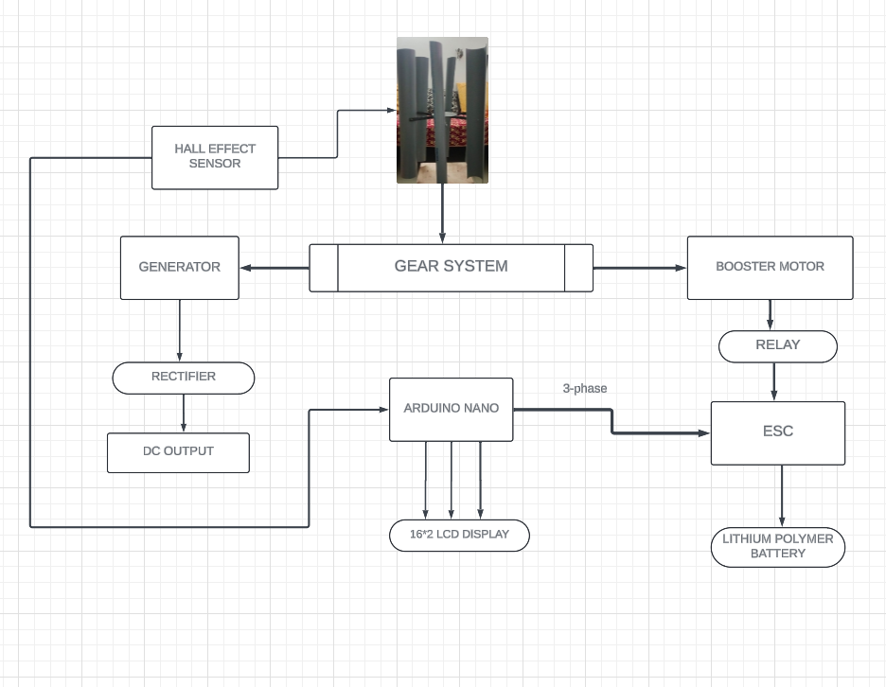
METHODOLOGY

Slide 6
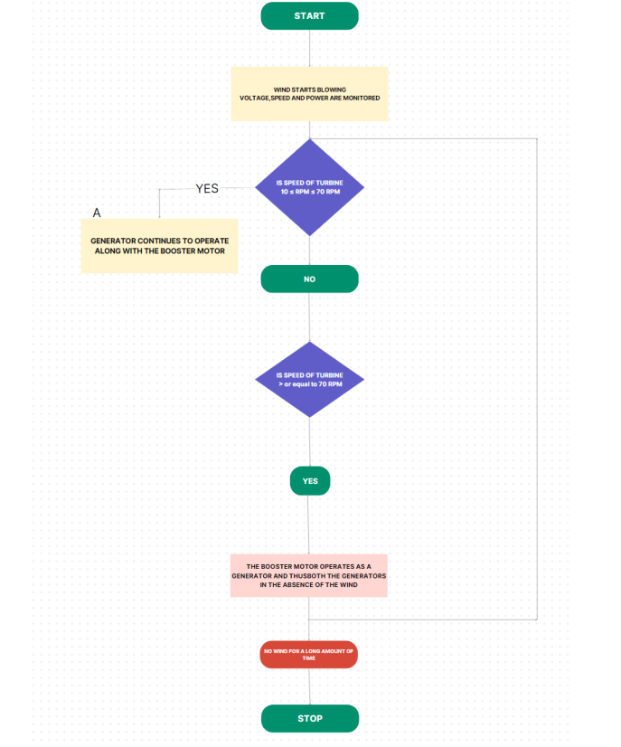

Slide 7
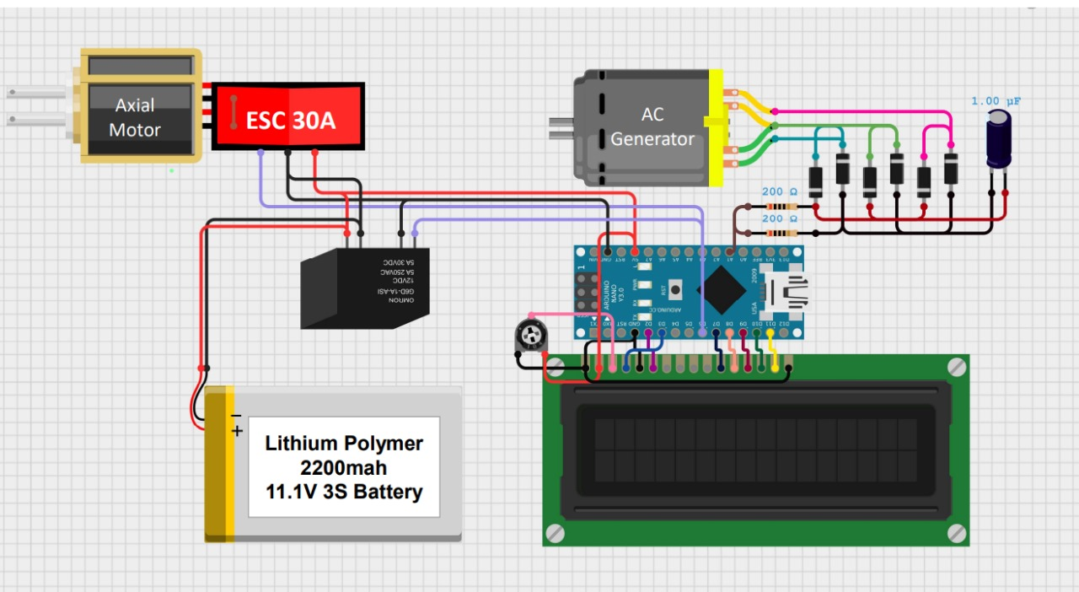

Slide 8
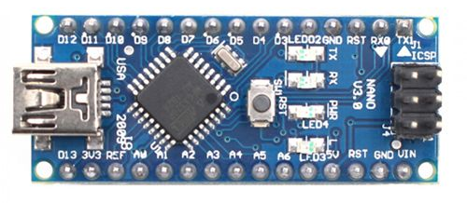
COMPONENTS
ARDUINO NANO

Slide 9
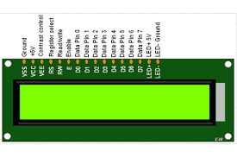
16*2 LCD Display

Slide 10
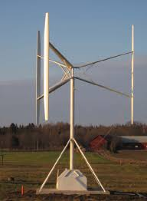
H-ROTOR WIND TURBINE

Slide 11
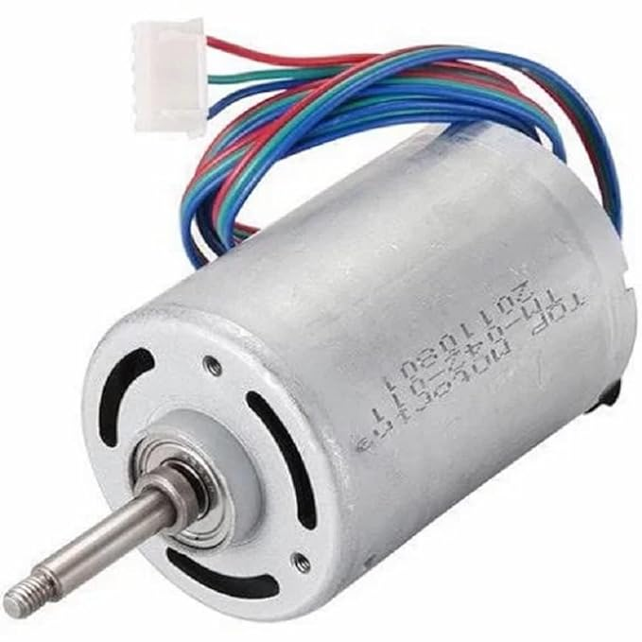
Three – phase miniature double bearing, Inner Rotor DC Brushless Motor High Voltage Dynamo
60 W
Voltage: DC 220V
Current: 0.28A
Drive speed: 1500RPM

Slide 12
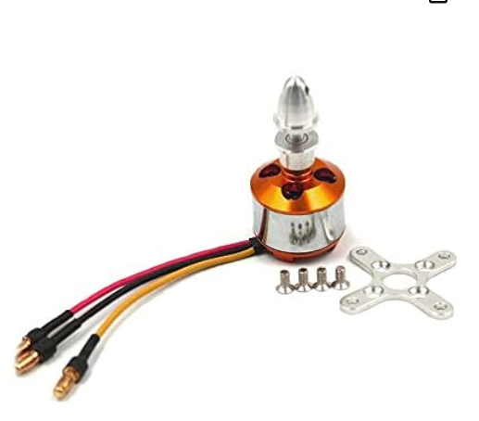
A2212 1400KV BLDC Brushless Motor
Motor KV: Max.1400
Efficiency Current: 6-12A
No Load Current: 0.7A @10V
Current Capacity: 16A

Slide 13
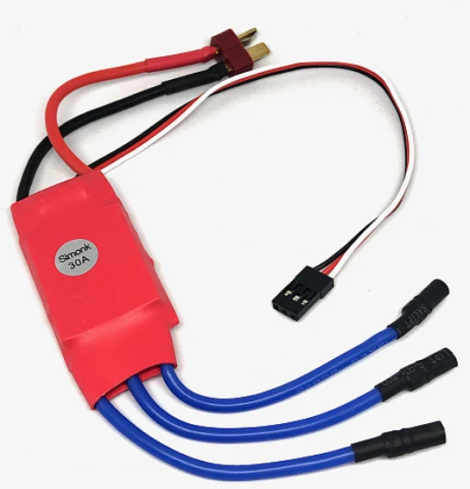
SimonK Red 30A BLDC ESC Electronic Speed Controller with Connectors

Slide 14
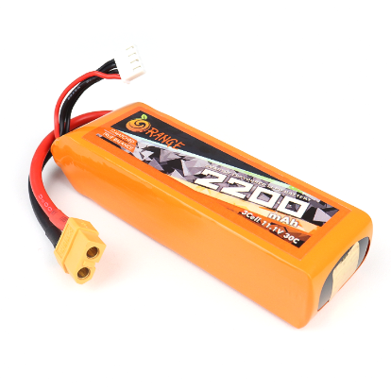
11.1V 2200mAh 30C 3S Lithium Polymer Battery Pack

Slide 15
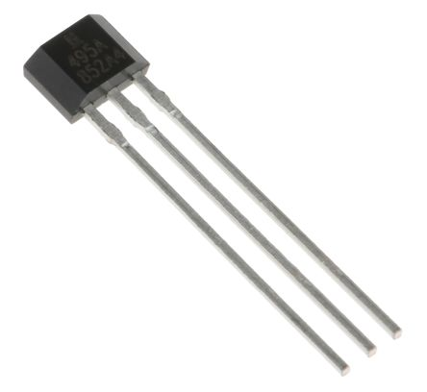
Hall Sensor

Slide 16
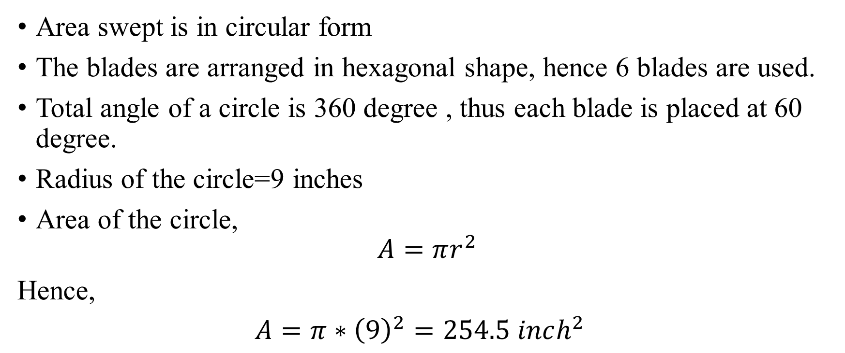
CALCULATIONS
Area swept is in circular form
The blades are arranged in hexagonal shape, hence 6 blades are used.
Total angle of a circle is 360 degree , thus each blade is placed at 60 degree.
Radius of the circle=9 inches
Area of the circle,
$$A=πr^{2}$$
Hence,
$A=π∗{\left(9\right)}^{2}=254.5 inch^{2}$

Slide 17
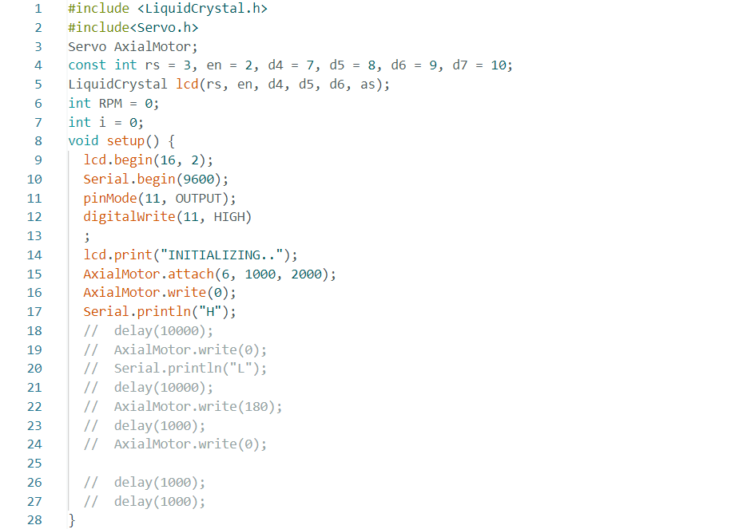
CODE

Slide 18


Slide 19
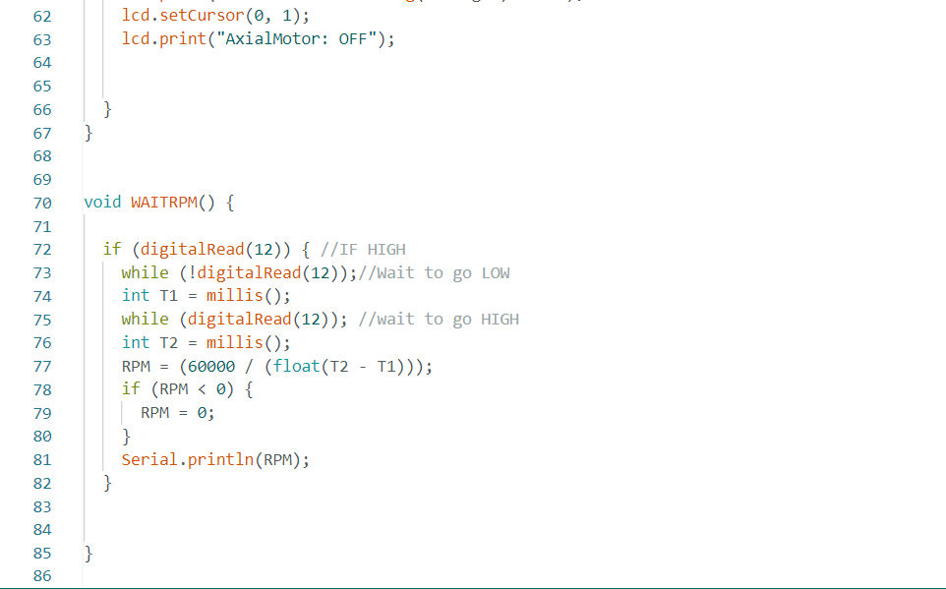

Slide 20
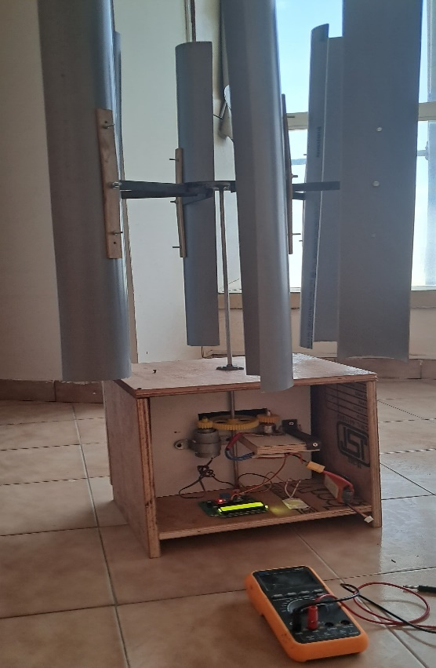
RESULTS AND DISCUSSIONS

Slide 21
Undisrupted working of the Vertical Axis Wind Turbine in the absence of wind.
Installed in Highways and Open Spaces increases the power generated.

Slide 22
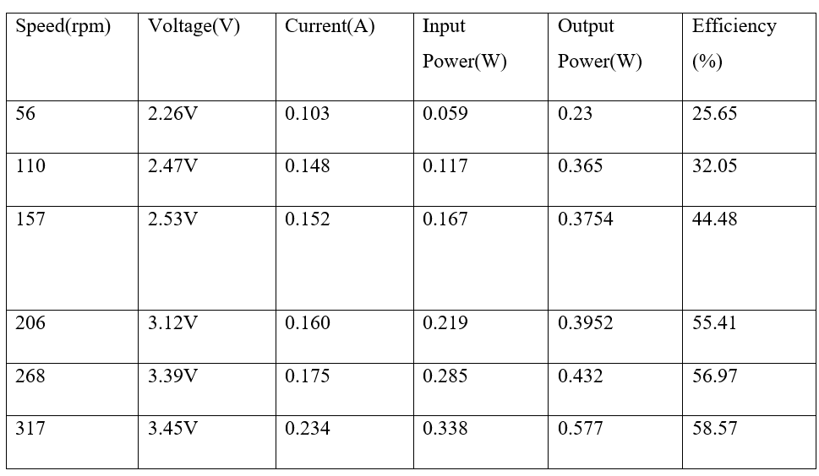
MEASURED VALUES

Slide 23
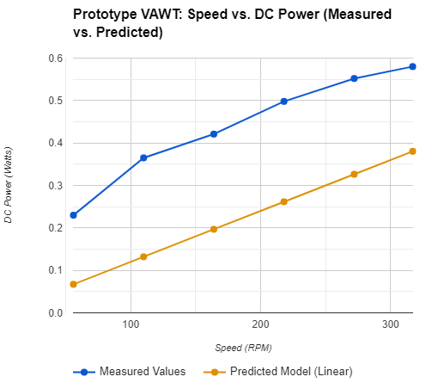
COMPARISON GRAPH

Slide 24
FUTURE SCOPE AND CONCLUSION
Hybrid Force Integration for Enhanced Efficiency
Advanced Control Systems
Innovative Materials and Hybrid Systems

Slide 25
THANK YOU!!

